Slide 1
Process Heat Transfer
Conduction and Radiation
Class 2

Slide 2
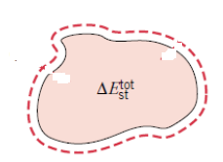
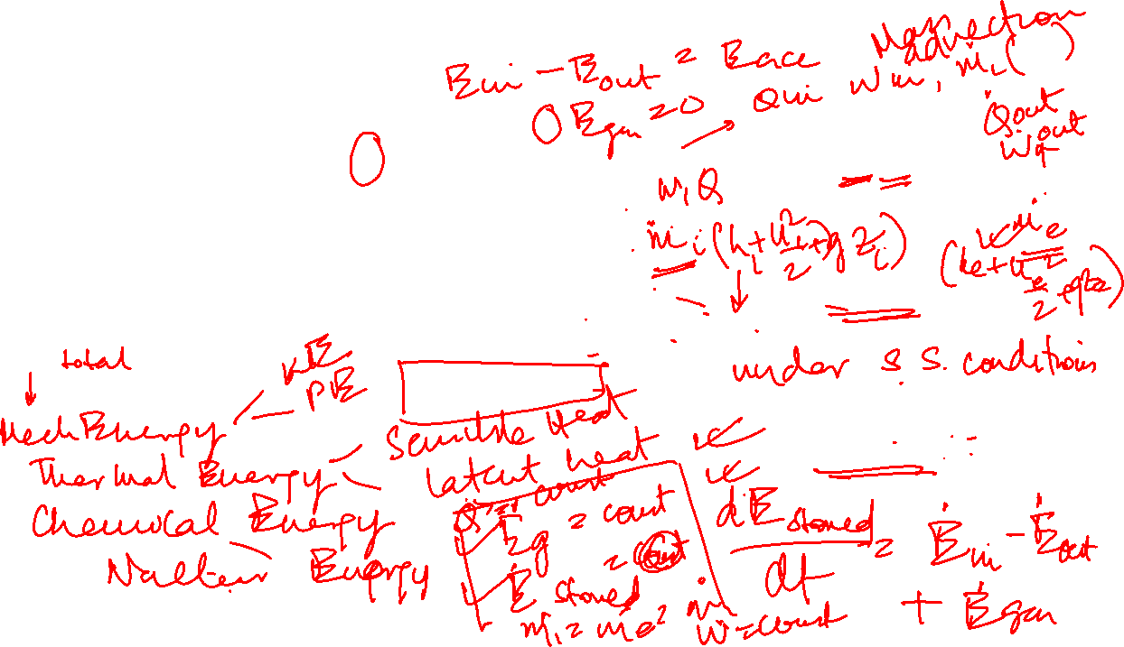



First Law of Thermodynamics
Isolated System
Closed System over a time interval
Open System at a particular time instant

Slide 3
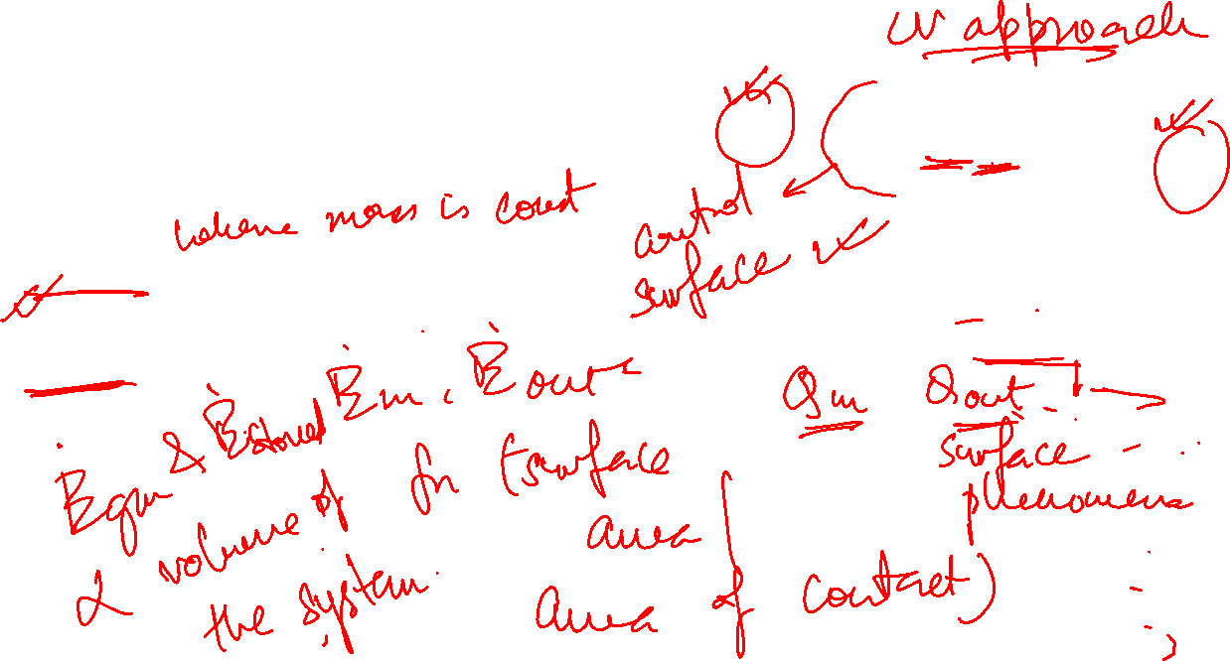
First Law of Thermodynamics
Open System at a particular time instant
Closed System over a time interval

Slide 4

Methodology to apply conservation laws
Identify appropriate CV with CS indicated by dashed line(s) to which analysis is applied.
Select appropriate time basis –
- Analysis to be performed over time interval Δt or rate basis
- Choice based on objective of solution and information given in problem
Identify the energy terms relevant to the problem and show each process on CV by suitably labelled arrows.
Apply conservation equation and substitute appropriate rate expressions for relevant terms in equation
Energy conservation requirement may be applied to
Finite CV – Resulting expression governs overall system behavior
Or
Differential CV – Differential equation solved for conditions at each point in system

Slide 5
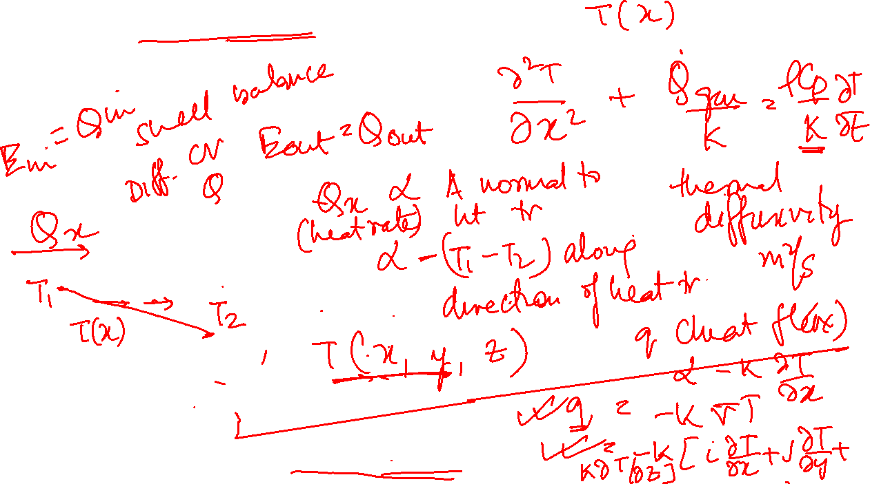
Generalized heat conduction equation in one dimension
Heat flux vector is in a direction normal to isothermal surface

Slide 6
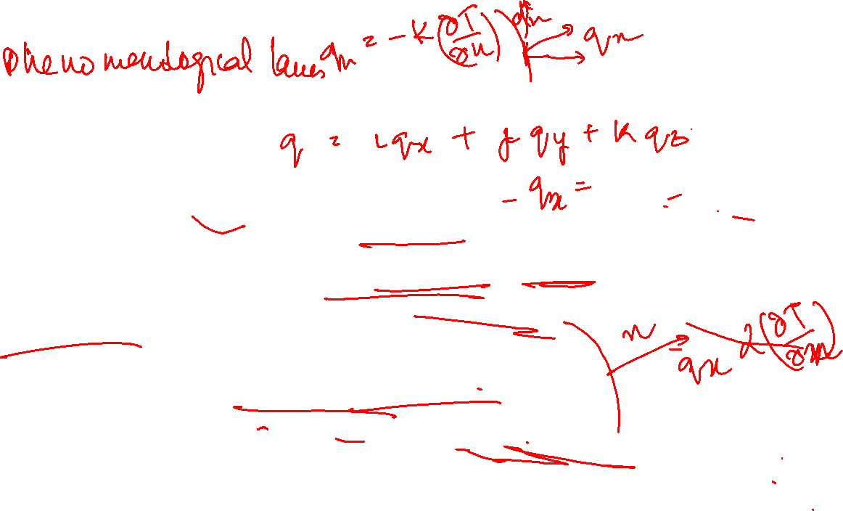
Key features of Fourier’s law
Generalisation based on experimental evidence and not an expression derived from first principles
Expression defines an important material property, k
Vector expression indicating that heat flux is normal to an isotherm and in direction of decreasing temperature
Applies for all materials regardless of state (solid, liquid, gas)

Slide 7
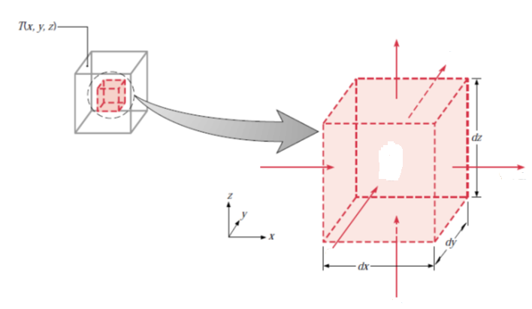
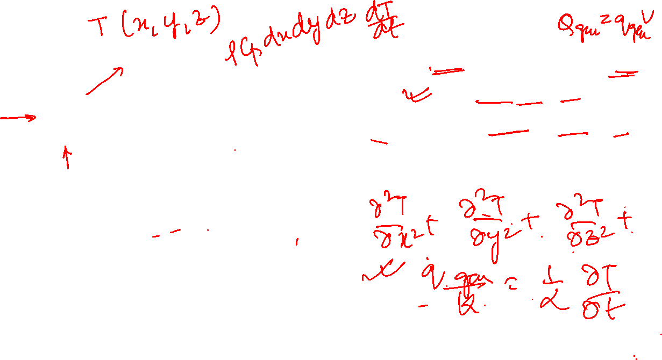
Differential control volume (dxdydz) for conduction analysis in Cartesian coordinates
For generalized case,
Qz+dz
Qy+dy
Qstored
Qx
Qx+dx
Qgen
Qy
Qz

Slide 8
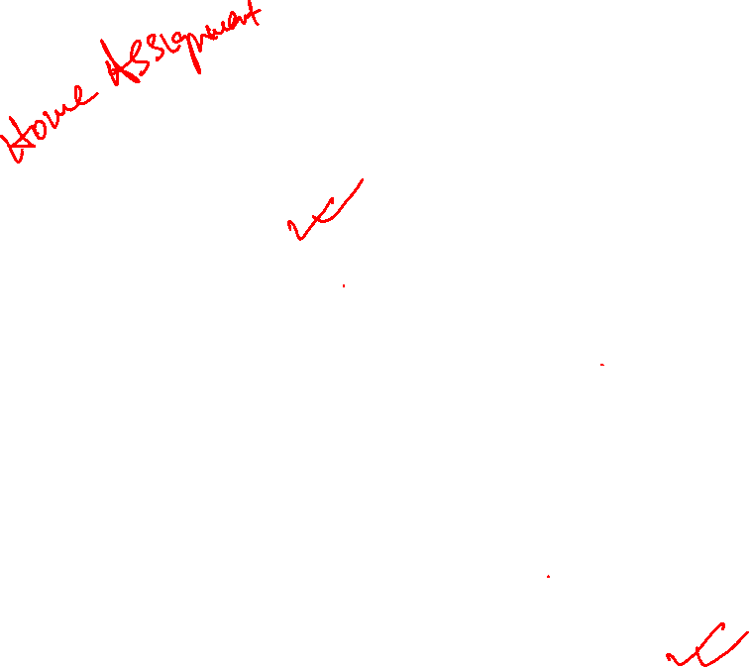
Differential control volume (dr.rdφ.dz) for conduction analysis in cylindrical coordinates (r, φ, z)
Qz+dz
Qφ
Qr+dr
Qr
Qφ+d φ
Qz

Slide 9
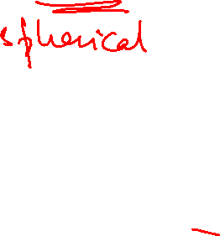
Differential control volume (dr.rsinθ.dφ) for conduction analysis in cylindrical coordinates (r, φ, θ)

Slide 10

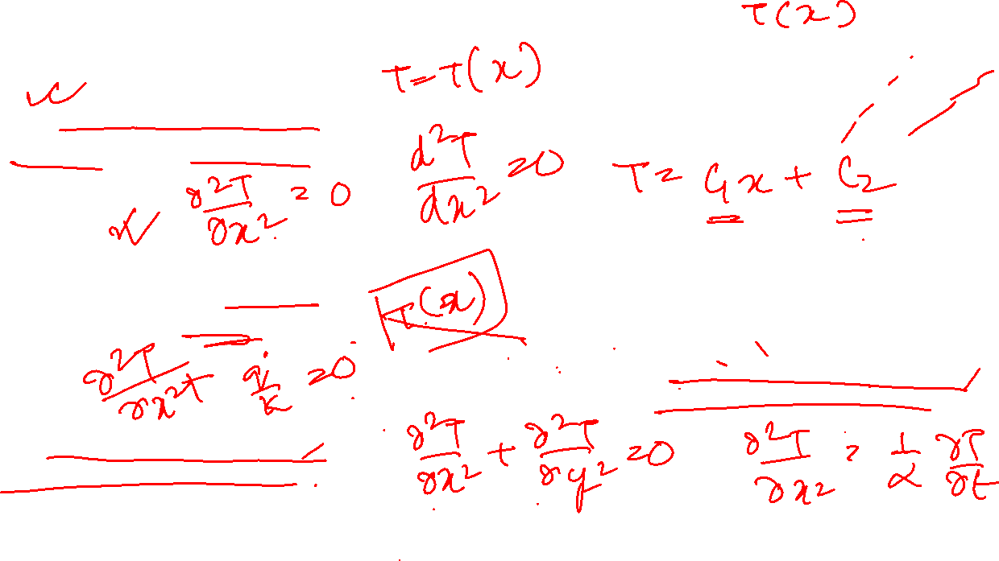
Control volume conduction analysis
Special Cases
One dimensional steady state heat conduction with no heat generation
One dimensional steady state heat conduction with heat generation
One dimensional unsteady state heat conduction with no heat generation
Two dimensional steady state heat conduction with no heat generation

Slide 11
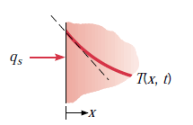
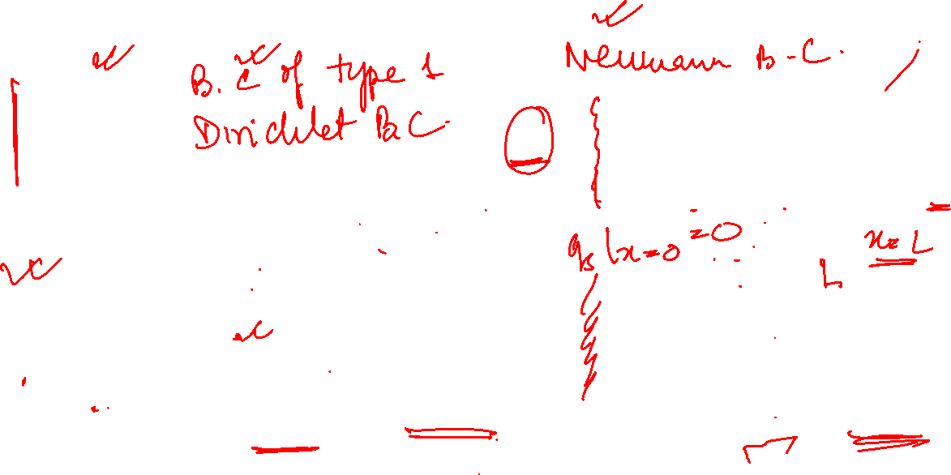
Boundary Conditions for heat diffusion equation at the surface (x = 0)
Constant surface temperature
Constant surface heat flux
Finite heat flux
Convection surface condition
Adiabatic/Insulated surface

Slide 12
Steps of calculation
Identify the known parameters in the problem
Identify the parameters to be estimated
Schematic of physical system with control surface(s) denoted by dashed lines and relevant heat transfer processes identified by suitably labelled arrows
List all pertinent simplifying assumptions
Compile property values required for calculations
Begin analysis by applying appropriate conservation laws and rate equations and develop analysis as completely as possible before substituting numerical values

Slide 13
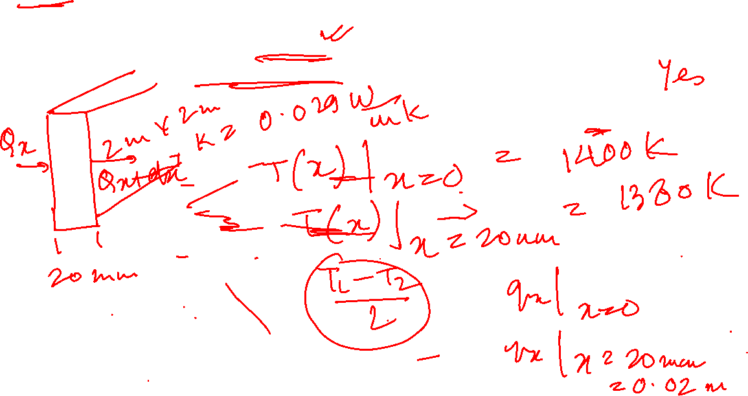
Example Problem
A 20 mm thick fireclay brick of cross sectional area (2m×2m) and thermal conductivity k = 0.029W/m(K) is operated under different thermal conditions. If the temperature distribution in the wall at any instant of time is T(x) = a+ bx where a = 1400K and b = (-1000)K/m, determine the heat flux and heat rates at x=0 and x=20 mm. Do steady state conditions exist?

Slide 14
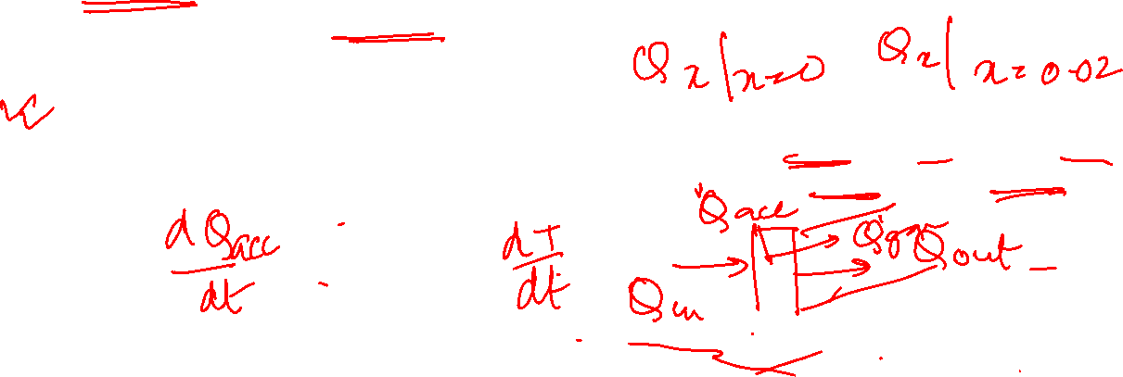
Example Problem
A 20 mm thick fireclay brick of cross sectional area (2m×2m) and thermal conductivity k = 0.029W/m(K) is operated under different thermal conditions. If the temperature distribution in the wall at any instant of time is T(x) = a+ bx where a = 1400K and b = (-1000)K/m, determine the heat flux and heat rates at x=0 and x=20 mm.
Repeat problem with temperature distribution across wall at any time instant as – [c= (-300)K/m2]
A uniform heat generation of 1000W/m3 is present in the wall having properties –
Determine (i) the rate of heat transfer into (x=0) and out of the wall (x=L) (ii) the rate of energy storage in the wall (ii)the time rate of temperature change at x=0.01m and x=0.015m

Slide 15
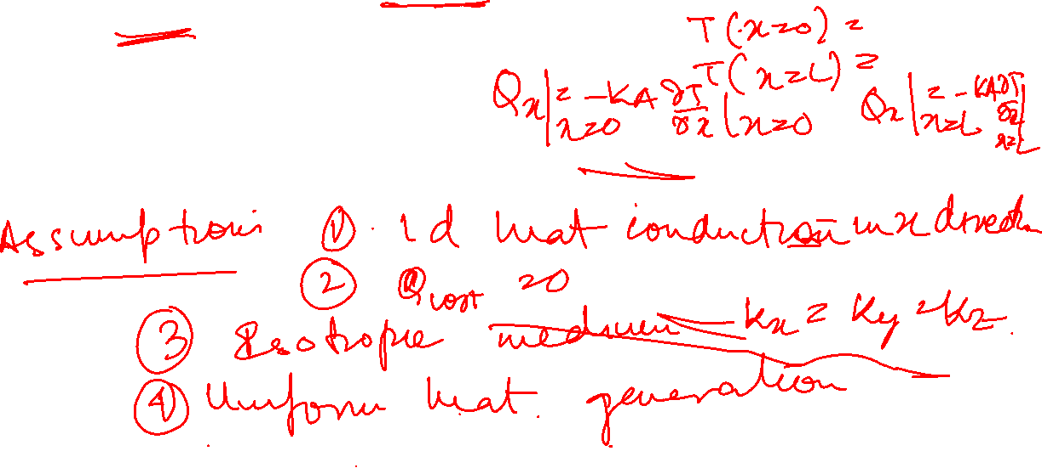
Example Problem
A 20 mm thick fireclay brick of cross sectional area (2m×2m) and thermal conductivity k = 0.029W/m(K) is operated under different thermal conditions. If the temperature distribution in the wall at any instant of time is– [c= (-300)K/m2] and a uniform heat generation of 1000W/m3 is present in the wall having properties –
Determine (i) the rate of heat transfer into (x=0) and out of the wall (x=L) (ii) the rate of energy storage in the wall (ii)the time rate of temperature change at x=0.01m and x=0.015m

Slide 16
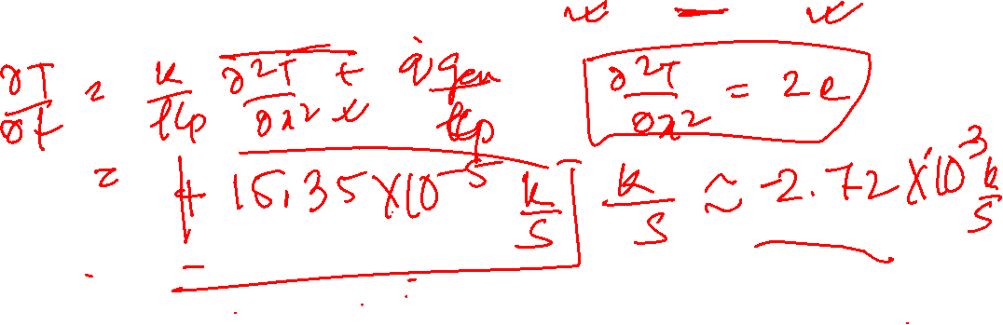
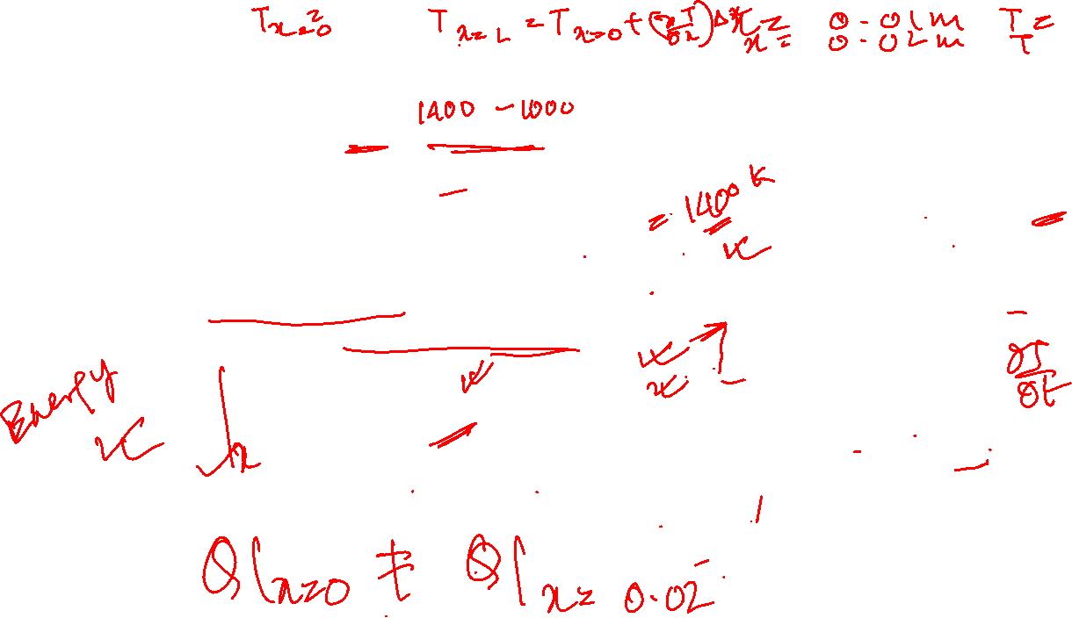

Example Problem
A 20 mm thick fireclay brick of cross sectional area (2m×2m) and thermal conductivity k = 0.029W/m(K) is operated under different thermal conditions. If the temperature distribution in the wall at any instant of time is– [c= (-300)K/m2] and a uniform heat generation of 1000W/m3 is present in the wall having properties –
Determine (i) the rate of heat transfer into (x=0) and out of the wall (x=L) (ii) the rate of energy storage in the wall (ii)the time rate of temperature change at x=0.01m and x=0.015m

Slide 17
Example Problem
A 20 mm thick fireclay brick of cross sectional area (2m×2m) and thermal conductivity k = 0.029W/m(K) is operated under different thermal conditions. If the temperature distribution in the wall at any instant of time is– [c= (-300)K/m2] and a uniform heat generation of 1000W/m3 is present in the wall having properties –
Determine (i) the rate of heat transfer into (x=0) and out of the wall (x=L) (ii) the rate of energy storage in the wall (ii)the time rate of temperature change at x=0.01m and x=0.015m

Slide 18
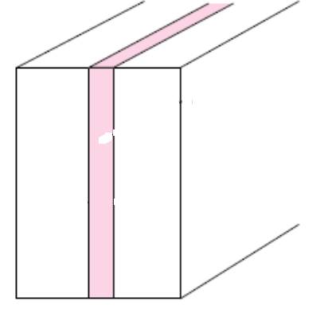

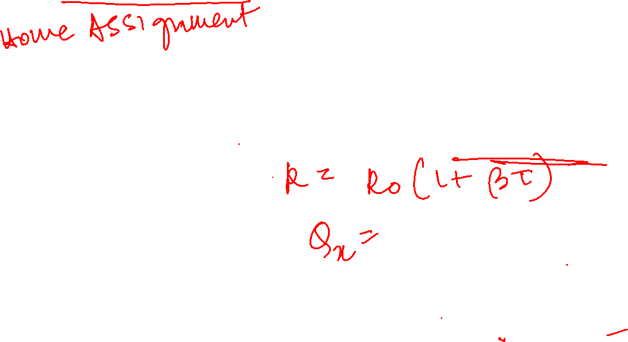

One dimensional steady state heat conduction in Cartesian coordinates
T =T(x)
Qx
If k linear function of temperature

Slide 19

One dimensional steady state heat conduction in Cartesian coordinates
T =T(x)
If more than one material is present (3 layered composite wall)
T1
T2
T3
T4
Qx
kb
ka
kc

